Slide 1
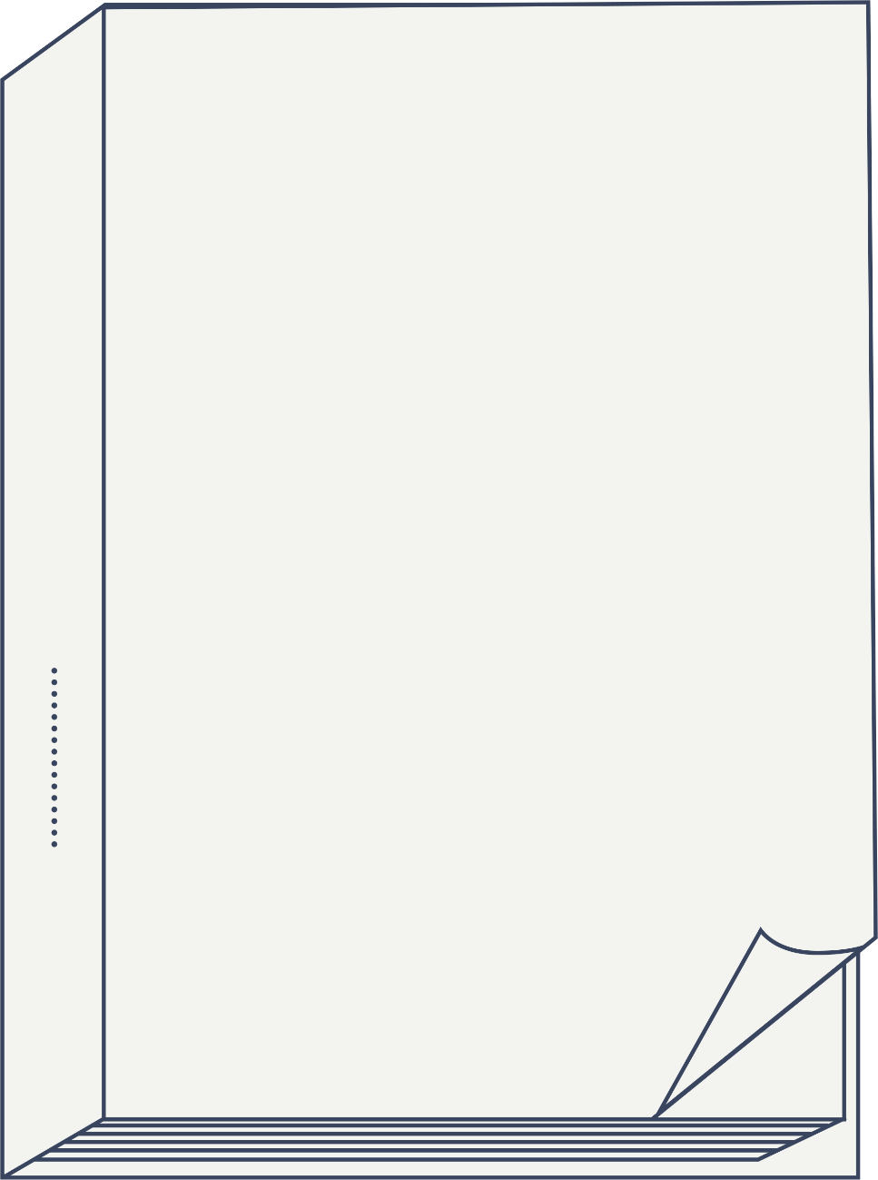
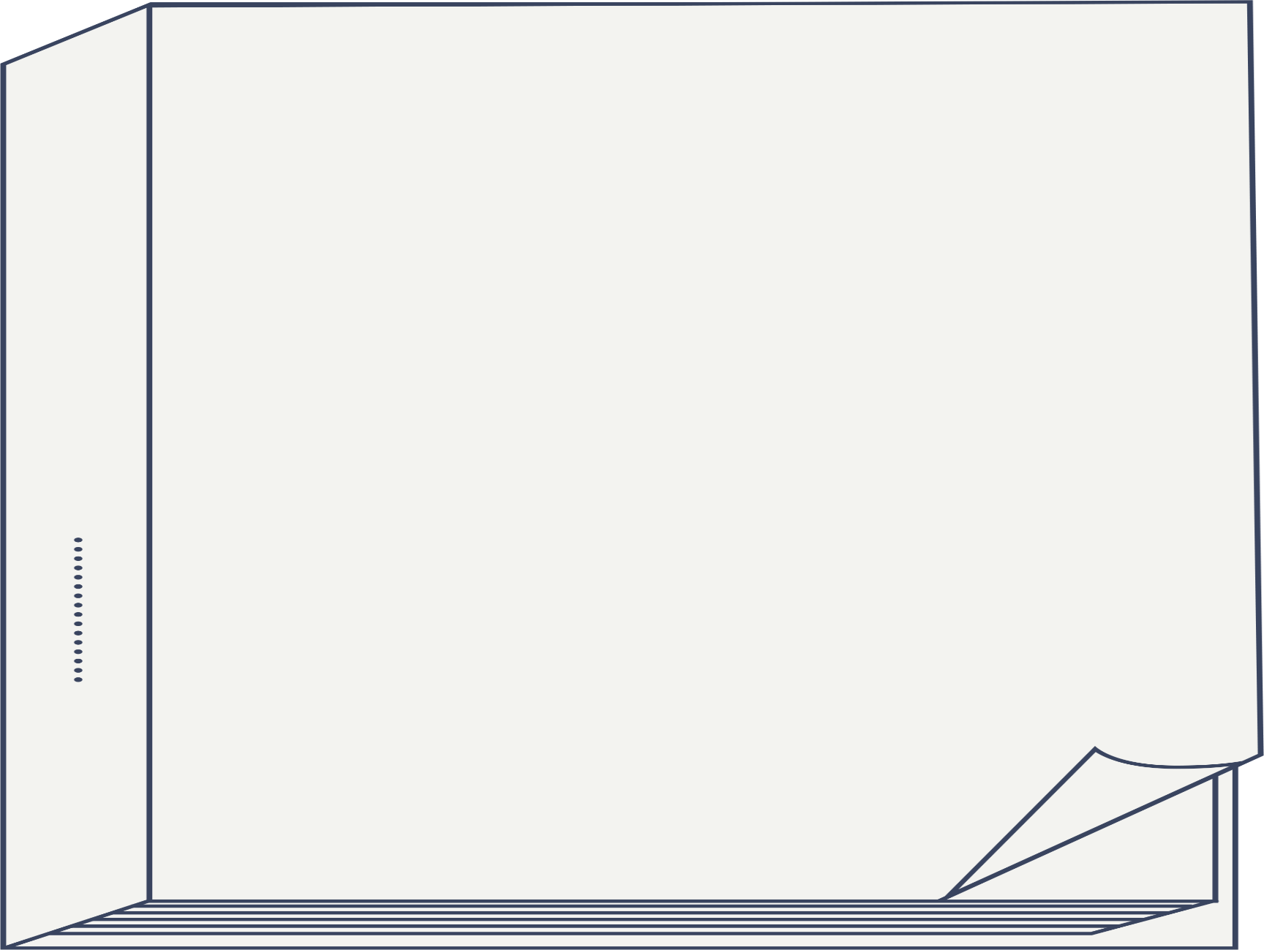


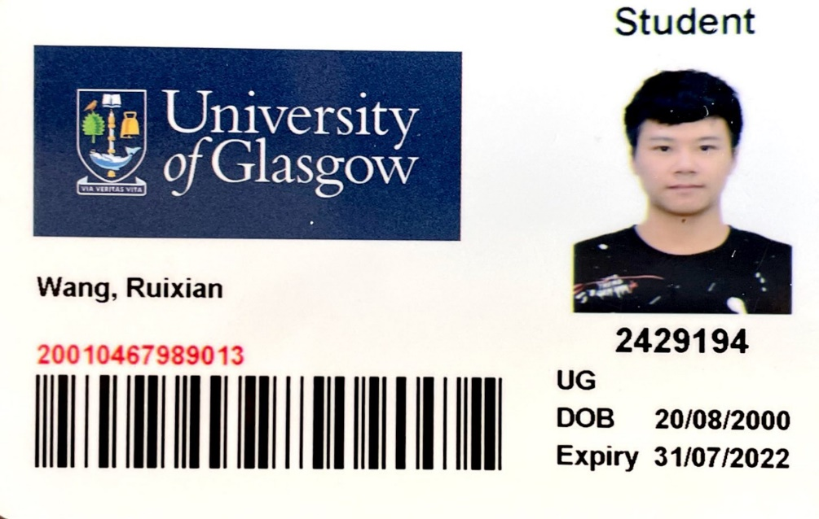
Final Project Presentation
Deep Clothes Wearing Classification in Video
GUID:2429194
UESTC:2018190601026
Reporter: Wang Ruixian

Slide 2

CONTENTS
Project background and significance
01
02
Project methods and ideas
03
Experiment and result display
04
Reflection and project conclusion

Slide 3
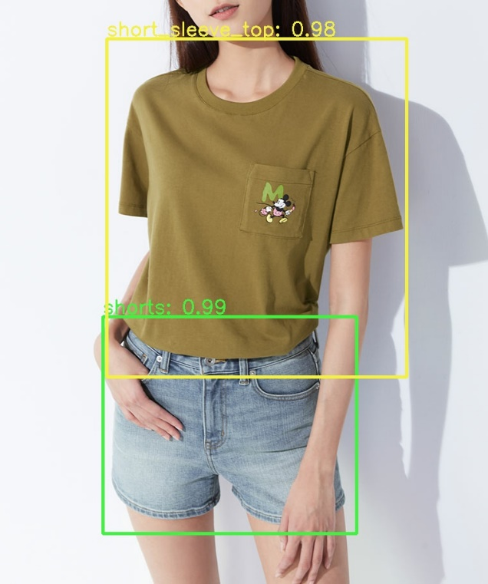
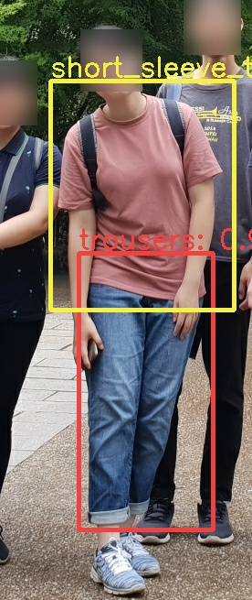
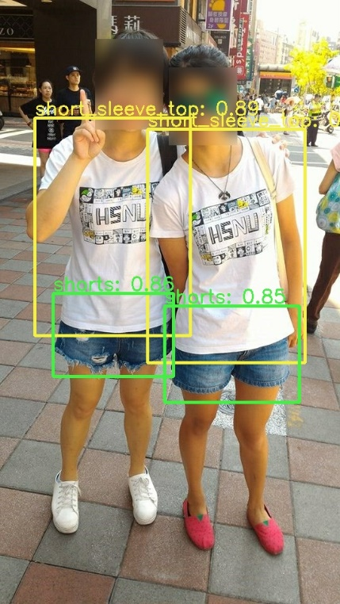
01
Project Background and
Significance
With the development of the Internet, clothes detection technology has become particularly important and is of wide interest, especially in the context of map-based search for e-commerce platforms and monitoring security systems.

Slide 4
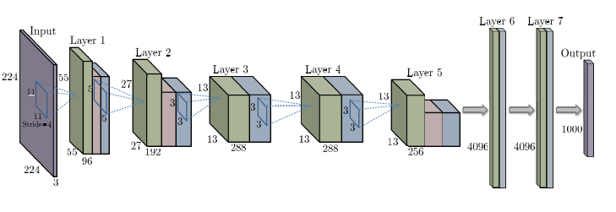
02
Project methods and ideas
2.1Foundations of Deep Learning Algorithms
Deep Convolution Neural Network

Slide 5
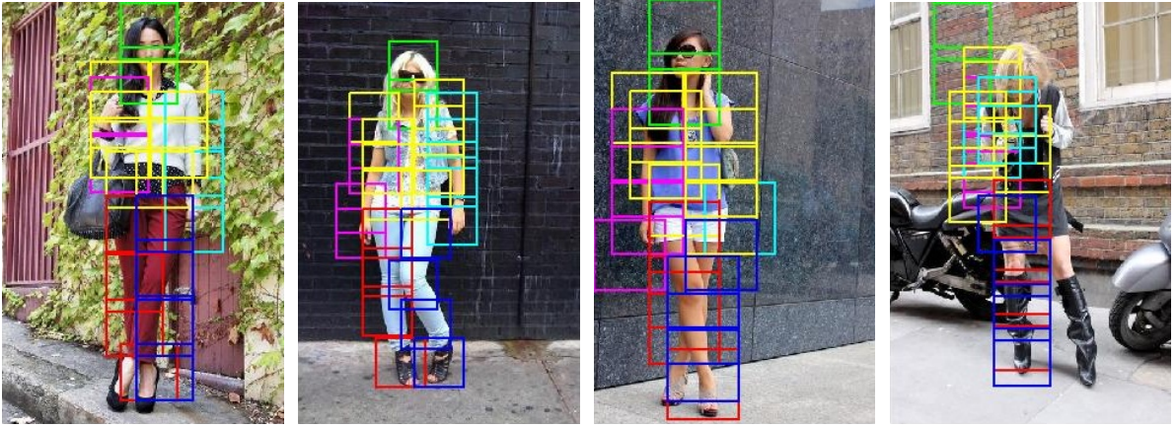
2.2 Related Work
Kalantidis proposed an automatic clothing suggestions using arbitrary photos. They perform human pose estimation to segment the images in 26 body parts. Then, they segment and cluster the clothing using Approximate Gaussian Mixture clustering. After segmenting the clothing, they then perform classification to suggest the most similar clothing

Slide 6
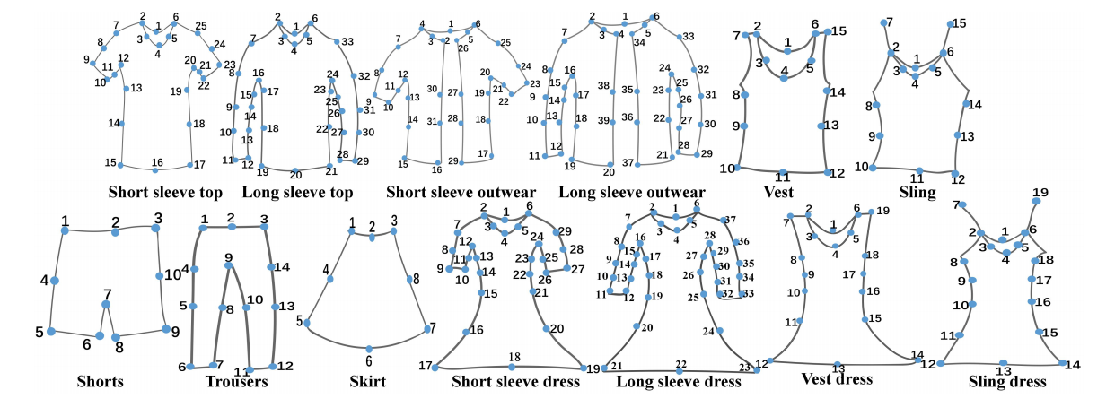
2.3 Dataset DeepFashion2
However, our work make use of the newly release Deep Fashion 2 dataset to train a object detection network, thus omitting the need of pose estimation and clothes segmentation.

Slide 7
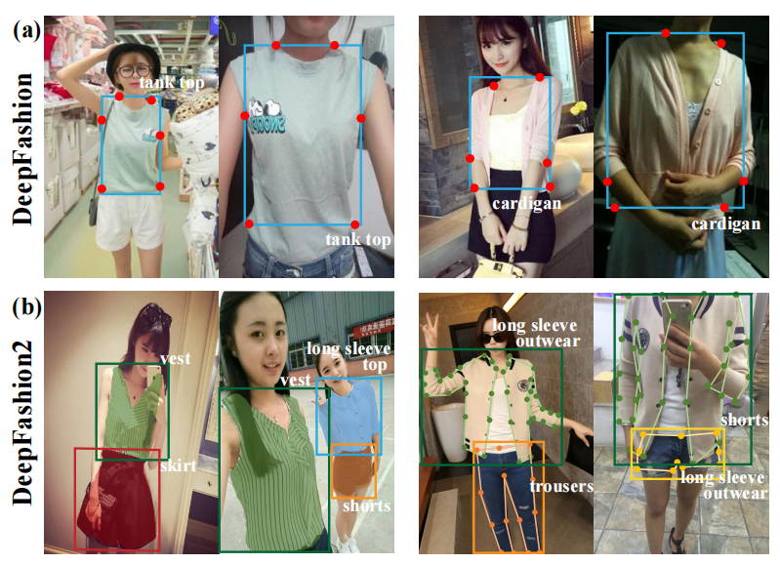
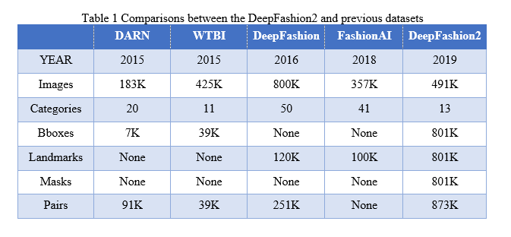
2.3 Dataset DeepFashion2
DeepFashion2 defines different landmarks for different categories, with 23 key points per landmark, higher than DeepFashion's 4-8 key points.
The Comparison between DeepFashion1 and 2

Slide 8
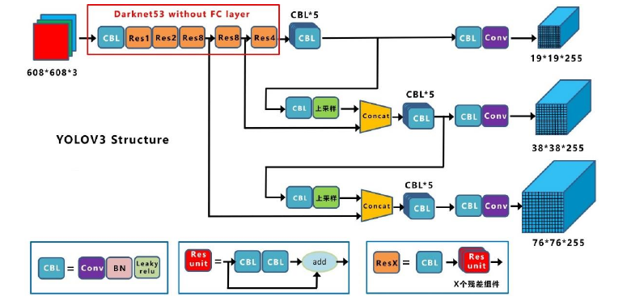
2.4 YOLOv3
This project uses one of the more effective algorithms in the target detection algorithm model, YOLOv3

Slide 9
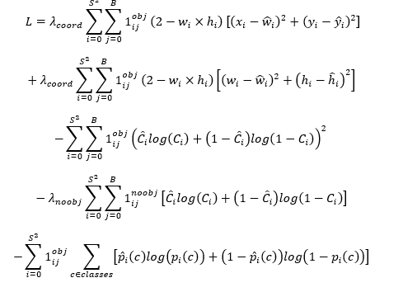
2.4 YOLOv3
The focus of the loss function in the YOLO version is mainly on the loss of the target category, the arithmetic of the target box position and the loss of the predicted region as the target

Slide 10
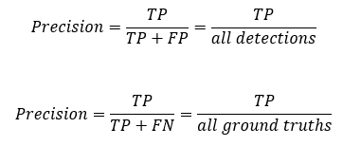
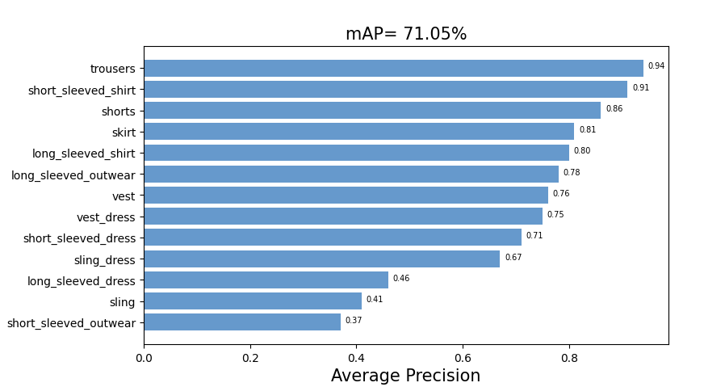
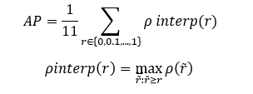
03
Experiment and result display
VOC mAP the equations used to judge the merits of the project's results Average Precision.

Slide 11
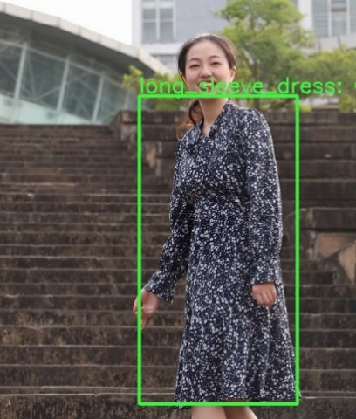
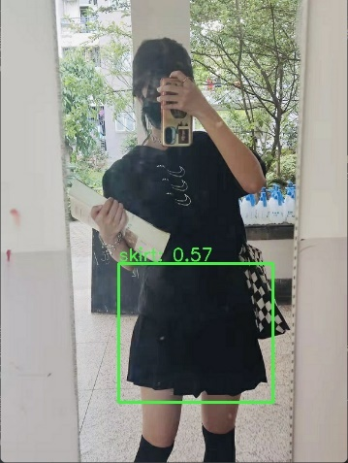
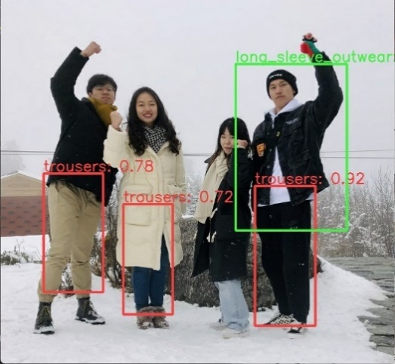
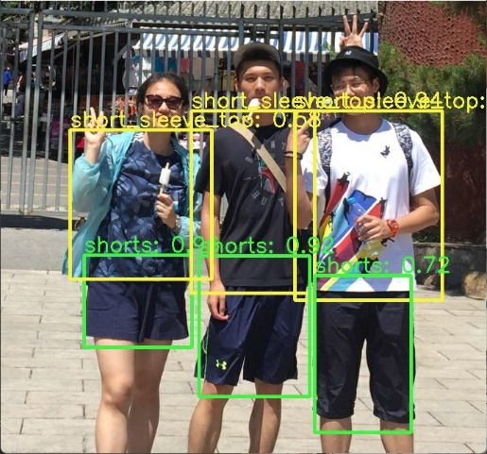
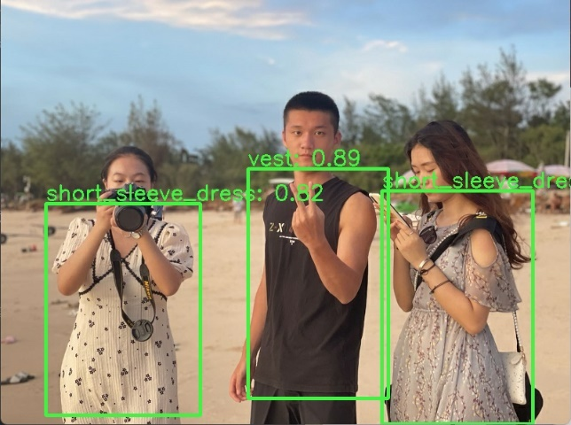
03
Experiment and result display
In order to distinguish between the different clothing types, the results are displayed with different coloured boxes circled and with the name of the clothing tested and the degree of certainty attached.
To save time and improve efficiency, judgements with a confidence level of 0.5 or less are not shown automatically.

Slide 12
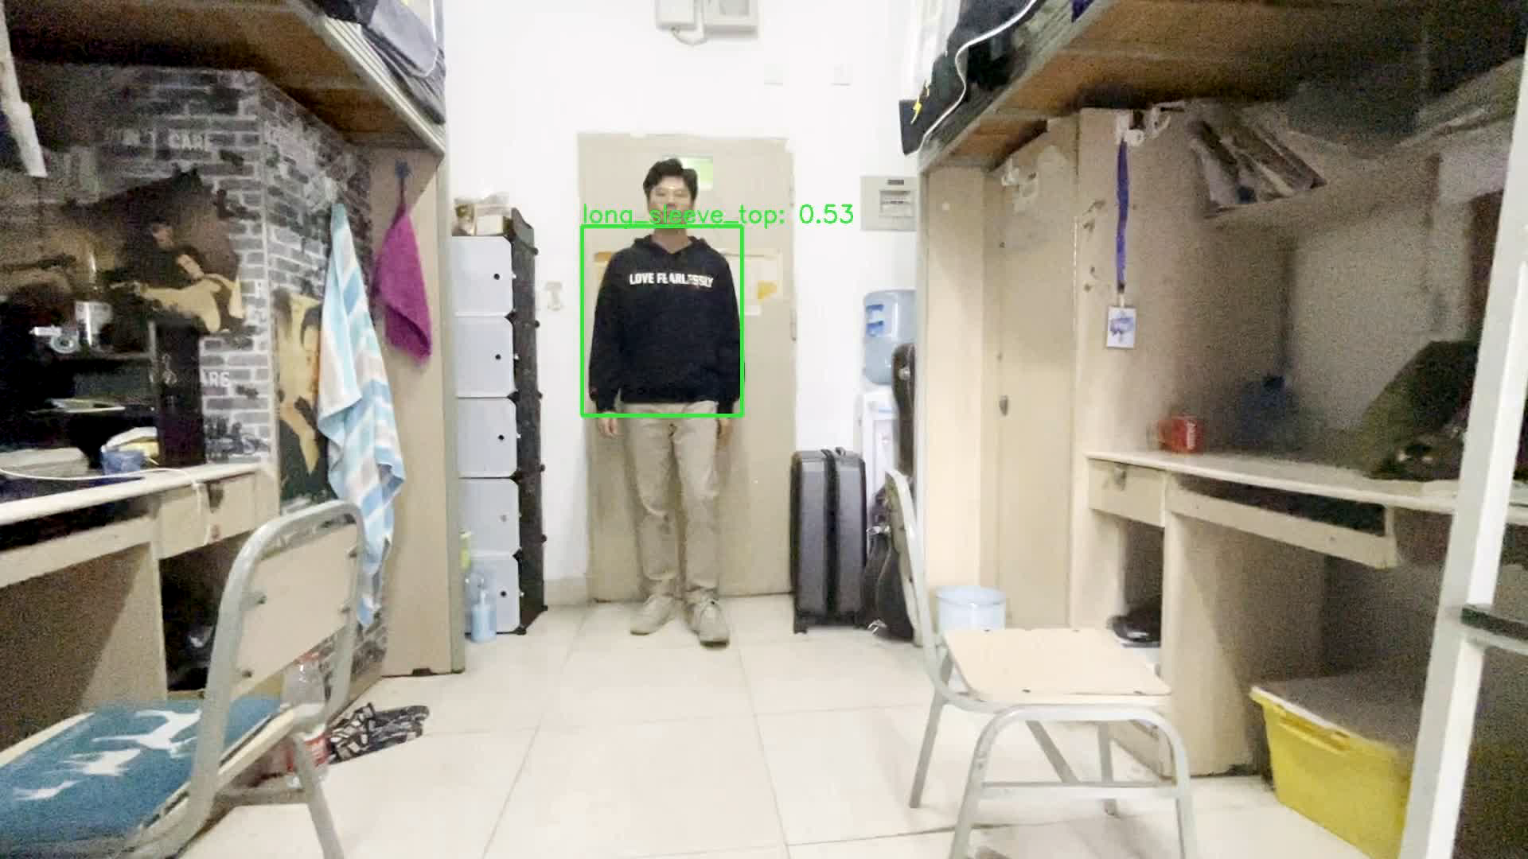
03
Experiment and result display
Result of Output in Video

Slide 13
04
Reflection and project conclusion
In this research, I have carefully studied the fundamentals of deep learning algorithms, learned to train and test with models, and have better research results on clothes detection results
A wide variation in accuracy between clothes categories emerged in the results. It is presumed to be related to the nodes of clothing in DeepFashion2 or that the dataset sample is not comprehensive enough

Slide 14
04
Reflection and project conclusion
This study is still essentially based on a single image for clothing recognition, with a large number of blurred and repeated frames in the video, which should continue to be improved in future studies
This study mainly used the YOLOv3 model and it is possible to compare the differences between the different models, such as YOLOv4 and SSD, in subsequent studies

Slide 15


Final Report Presentation
Thanks for Listening

